Slide 1
FY24 Budget Approval Meeting

Slide 2
Norms
This is a meeting of the GO Team. Only members of the team may participate in the discussion. Any members of the public present are here to quietly observe.
We will follow the agenda as noticed to the public and stay on task.
We invite and welcome contributions of every member and listen to each other.
We will respect all ideas and assume good intentions.

Slide 3
Agenda
Action Items
Approval of Agenda
Approval of Previous Minutes
Budget Approval
Discussion Items
Presentation of the final budget
Information Items
Principal’s Report
BASC-3 Results
Spring ACES Presentation
Announcements

Slide 4
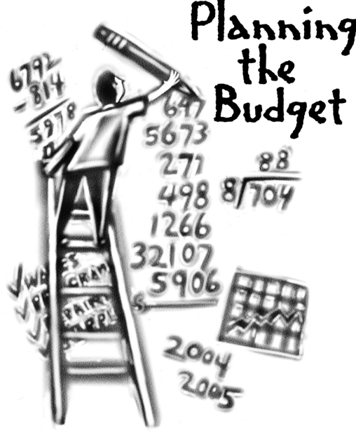
Overview of FY ‘24 GO Team Budget Process
Step 1 Review and Update Strategic Plan and Rank Strategic Priorities
By end of Fall Semester
Step 6 Principals: HR Staffing Conferences Begin
Late February – Early March
Step 3 GO Team Initial Budget Session: Allocation
January 24 – early February
Step 7 GO Team Final Budget Approval Meeting
Budgets Approved by March 17
Step 5
GO Team Feedback Session: Draft Budget Presented & Discussed
February – multiple meetings, if necessary
Step 4 Principals: Associate Supt. Discussions and Review
February (supports needed, specific challenges, coaching)
Step 2 Principals: Workshop FY 24 Budget
January 24, 2023
GO Teams are encouraged to have ongoing conversations about the school’s budget.

Slide 5
Budget Approval Meeting
What
During this meeting GO Teams will review the budget, which should be updated based on feedback from the staffing conference, Associate Superintendents, and key leaders. After review, GO Teams will need to take action (i.e., vote) on the FY24 Budget.
Why
Principals will present the final budget recommendations for GO Team approval.
When
All approval meetings must be held after staffing conferences. Budgets must be approved by March 17th.

Slide 6
Budget Review

Slide 7
FY24 Budget Parameters
FY24 School Priorities | Rationale
Increase the percent of students in grades 6-8 scoring proficient or above on the ELA GMAS by 3% from 15.3% to 18.3% by June 2023. | Implement the coaching cycle to improve instruction based on classroom observation and student performance.
Increase the percent of students in grades 6-8 scoring proficient or above on the MATH GMAS by 3% from 15% to 18% by June 2023.. | Provide differentiated job-embedded professional learning on curricular resources (amplify, text, etc)
Attend to the mental and social well being of students in order to Increase student attendance (CCRPI) from 79.3% to 85% by June 2023. | The CARE Team will refine and monitor attendance initiatives and student wellness with comprehensive wrap around supports.
Notes:
Review the priorities that the GO Team has developed and the rationale for these priorities. Feel free to copy this slide if you have more than 3 priorities to account for.

Slide 8
Staffing Conference Changes
Principals –indicate on this slide if there were any changes made to your budget proposal at your staffing conference. If there were no changes, please just cover the Budget by Function on slides 7 & 8 as a quick summary for your GO Team. If there were changes, please summarize for your team and then discuss the NEW Budget by Function values.
There were changes made to the draft budget we discussed at our last meeting.
These changes reflect an allocation change of + $32,000.

Slide 9
Summary of Changes
Change at Staffing Conference | Impact to Proposed Budget
Included a Signature Program Specialist | Funds from the Title I Holdback budget line was released giving us enough funds to fund our Signature Program Specialist position.

Slide 10
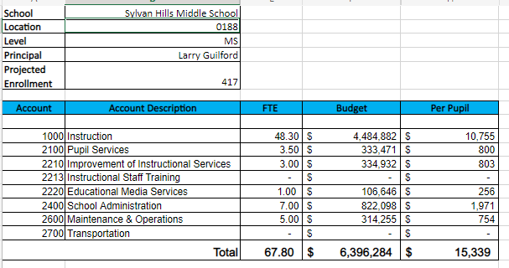
Budget by Function (Required)
*Based on Current Allocation of School Budget

Slide 11
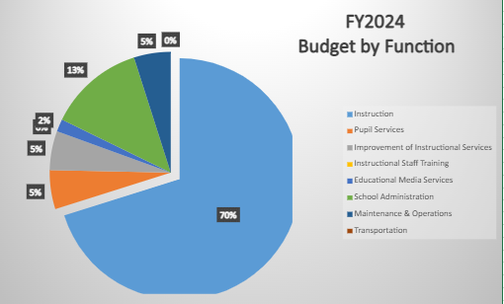
Budget by Function (Required)
*Based on Current Allocation of School Budget

Slide 12
Questions?

Slide 13
The GO Team needs to TAKE ACTION (vote) on the presented budget. After the motion and a second, the GO Team may have additional discussion. Once discussion is concluded, the GO Team will vote.
Action on the Budget

Slide 14
BASC-3 Data

Slide 15
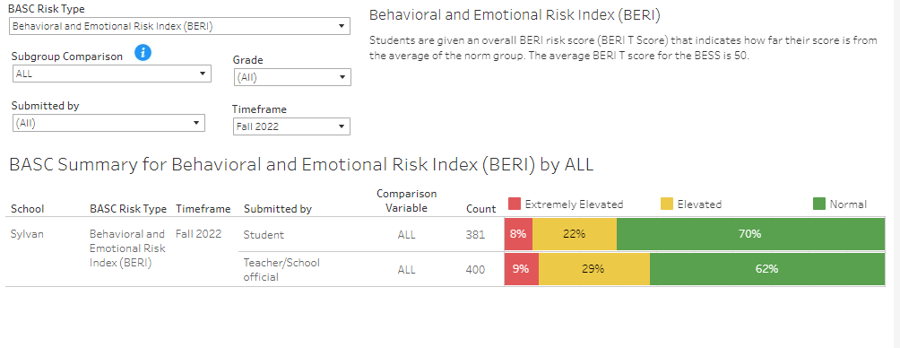
Fall BASC-3 Data

Slide 16
2023 Spring ACES
NOTE to Principal: Please insert your Spring ACES presentation after this slide.
Accountability
Collaboration
Equity
Support

Slide 17
Questions?

Slide 18
Thank you

